Slide 1
Air Pollution Based Street Light Controller
Team Members:
124B2E036 Shyam Nahate
124B2E032 Manas Mundada
124B2E031 Abhishek Patil
123B1E169 Kaushik Kakade
Guide:
Mrs. Sangita Ajit Patil
Department of Electronics and Telecommunication Engineering

Slide 2
Outline
Introduction
Literature Survey
Gap Identification
Problem Statement
Objectives
Proposed Methodology
Bibliography

Slide 3
Significance of Study
Global Problem: Urban air pollution is a critical public health and environmental issue, especially in densely populated cities.
Municipal Challenges: Street lighting is one of the largest contributors to energy costs in urban infrastructure. Static, non-adaptive systems waste electricity and increase operational expenses.
Integration Need: Existing solutions either focus only on illumination or only on air quality monitoring. There is a lack of integrated, cost-effective systems that leverage shared infrastructure.
Proposed Impact:
Real-time monitoring of pollution levels at street level.
Adaptive lighting improves safety during poor air quality while saving energy in low-pollution periods.
Low-cost deployment enables scalability across smart cities.
Dual-purpose infrastructure supports sustainability and public health awareness.

Slide 4
Symptoms with Main Causes of Stress
Conventional street lighting systems are static, operating at fixed brightness regardless of environmental conditions. Existing pollution monitoring systems are separate and not integrated with public infrastructure.
Symptoms:
Energy Waste: Lights remain at full brightness even when pollution levels are low or streets are empty.
High Costs: Continuous full-power operation increases municipal electricity bills.
Lack of Awareness: Citizens remain unaware of real-time pollution levels in their locality.
Reduced Safety: Current systems do not adjust brightness during high pollution, limiting visibility and public safety.
Environmental Burden: Excess energy use indirectly contributes to higher carbon emissions.

Slide 5
Multidimensional Indications to Identify
The system identifies the need for streetlight intensity adjustment based on air quality indicators, derived from multiple steps:
Gas Concentration Sensing:
MQ-135 sensor detects pollutants such as CO₂, CO, NOx, and VOCs.
The analog resistance change reflects the level of pollutants in the surrounding air.
Signal Conditioning & Calibration:
Raw sensor output is calibrated against reference AQI data.
Temperature and humidity compensation ensures higher reliability.
Data Processing (ESP32):
ESP32 applies filtering (rolling median / low-pass) to smooth sensor noise.
Pollution bands are derived (Good, Moderate, Poor) based on threshold values.
Lighting Control Decision:
Good → 40% brightness (energy saving).
Moderate → 70% brightness (balance).
Poor → 100% brightness + alert notification.

Slide 6
Methods of Air Quality Detection
Gas Sensor (MQ-135):
Detects CO₂, CO, NOx, and VOCs.
Provides analog resistance values proportional to pollutant concentration.
Sensor Calibration:
Baseline calibration against reference AQI data.
Linear regression mapping raw values to standardized pollution bands.
Periodic recalibration to account for sensor drift.
Compensation Techniques:
Temperature & humidity compensation using auxiliary sensors (e.g., DHT22/BME280).
Rolling median/low-pass filtering to reduce noise.
Data Fusion (Optional):
Integration with PM sensors (e.g., SDS011) for higher accuracy.
Rule-based logic to minimize false positives.
Classification into Pollution Bands:
Good → Safe, energy-saving dim mode.
Moderate → Balanced brightness.
Poor → Full brightness + alert for safety.

Slide 7
Literature Survey paper 1
Sr. no. | Title | Year of Publication | Publisher | Methodology | Conclusion
01 | Smart Street Light Control: A Review on Methods, Innovations, and Extended Applications | 2023 | MDPI (Energies journal) | Comprehensive literature review analyzing various smart street lighting control methods from static to AI-based approaches, introducing a novel light scheme framework for classification. | Smart street lighting systems can achieve 30-90% energy savings depending on control methods employed, with AI and computer vision techniques showing the most promise for future sustainable urban lighting solutions.

Slide 8
Literature Survey paper 2
Sr. no. | Title | Year of Publication | Publisher | Methodology | Conclusion
02 | Self-Activating Street Lights Using Sensors and Arduino | 2021 | IEEE | Created an automatic street lighting system using Arduino UNO with LDR and ultrasonic sensors to control LED brightness based on ambient light and motion detection. | The system achieves 32-45% energy savings through automatic brightness adjustment based on real-time environmental conditions, providing cost-effective smart lighting solution.

Slide 9
Literature Survey paper 3
Sr. no. | Title | Year of Publication | Publisher | Methodology | Conclusion
03 | Orchestrating a Sustainable, Energy-Efficient LoRa-Connected Lighting System for Next-Generation Smart Cities | 2023 | IEEE | Developed a LoRa-based smart street lighting system with STM32 controllers, featuring street light monitoring nodes and routing nodes for long-range wireless communication and real-time control. | The LoRa-based system demonstrates significant energy savings with reliable long-range communication capabilities, providing a scalable solution for smart city lighting infrastructure.

Slide 10
Literature Survey paper 4
Sr. no. | Title | Year of Publication | Publisher | Methodology | Conclusion
04 | Master Street Light System Integrating Automation and Air Pollution Monitoring for Urban Sustainability | 2024 | IEEE | Proposed a hierarchical master-student street lighting system where master lights equipped with sensors control adjacent lights, integrated with air pollution monitoring capabilities. | The master-student architecture significantly reduces installation costs while providing comprehensive environmental monitoring, offering a holistic solution for sustainable urban lighting.

Slide 11
Literature Survey Findings(1&2)
Smart Street Light Control: A Review on Methods, Innovations, and Extended Applications (Energies / MDPI, 2023). This review surveys sensor- and communication-driven control strategies for street lighting and finds that the field has moved from simple threshold-based ON/OFF and twilight switches toward multi-layered systems combining adaptive dimming, occupancy detection, and data-driven control. The authors catalog hardware approaches (LDRs, PIR, ultrasonic, cameras, LiDAR), communication technologies (PLC, Zigbee, LoRa, NB-IoT, cellular) and software advances (edge analytics and ML for anomaly detection and predictive dimming). Important innovations identified include smart poles that integrate environmental sensors (air quality, noise), energy harvesting and solar+storage integrations, and convergence with other city services (traffic sensing, EV charging). The review highlights measured benefits (notably energy and maintenance savings) but stresses challenges: interoperability, cyber-security, standards gaps, and the need for field validation under diverse urban conditions.
Self-Activating Street Lights Using Sensors and Arduino (IEEE conference paper — ICCCT 2021). This conference paper presents a low-cost prototype and its survey findings: simple microcontroller-based designs (Arduino) with LDR and motion or IR sensors can reliably provide automatic ON/OFF operation and basic dimming to reduce nighttime energy consumption. The authors report straightforward energy savings in test deployments and emphasize accessibility for small municipalities or communities because of low component cost and ease of construction. The survey-style discussion in the paper underscores limitations for scaling: single-node designs lack networked management, have limited diagnostics and no remote telemetry, and require physical maintenance and calibration—so while great for proof-of-concept and rapid deployment, they don’t by themselves meet smart-city requirements for large-scale automated fleets.

Slide 12
Literature Survey Findings(3&4)
Orchestrating a Sustainable, Energy-Efficient LoRa-Connected Lighting System for Next-Generation Smart Cities (IEEE conference paper, Sep 2023). The paper surveys and demonstrates a LoRa-based architecture for streetlighting that prioritizes low-power, long-range connectivity to enable distributed nodes (LED drivers + sensors) to be centrally orchestrated. Findings emphasize that LoRaWAN (or custom LoRa links) lets operators perform remote dimming, fault detection and schedule updates with minimal power overhead and at lower infrastructure cost than cellular. The authors show that combining local sensor-driven control (ambient light + motion) with occasional LoRa uplinks achieves significant net energy savings while retaining scalability across wide urban areas; however, the survey notes tradeoffs — limited per-node bandwidth restricts rich telemetry and firmware updates, and network planning (gateway placement, interference) is critical for reliable coverage.
Master Street Light System Integrating Automation and Air Pollution Monitoring for Urban Sustainability (IEEE conference paper — ICICV 2024). This work surveys integrated smart-pole concepts where streetlight controllers are combined with environmental monitoring (PM2.5, CO/NOx sensors) and automated control. The reported findings show the value of multiservice poles: the same communications and power infrastructure can support both adaptive lighting and city sensing, enabling more holistic urban management (e.g., dim lights when no traffic while still streaming pollution alerts). The authors highlight benefits such as aggregated operational cost savings, improved situational awareness for city planners, and the potential to trigger dynamic responses (e.g., adjust traffic signaling or issue public health alerts). Limitations in the survey include sensor calibration drift, data quality/validation needs, and the increased complexity and cost of integrating heterogeneous sensors and ensuring reliable telemetry — all requiring robust maintenance and standards.

Slide 13
Problem Statement
Municipalities face rising energy costs and urban pollution, highlighting the need for a cost-effective integrated system that combines street lighting control with real-time air quality monitoring for safety and sustainability

Slide 14
Aim
This project aims to develop a cost-effective smart street lighting system using MQ-135 sensors and ESP32 that adapts brightness based on air quality, reducing energy use while enhancing public safety.

Slide 15
Gap Identification
Existing systems are single-purpose: either lighting control OR pollution monitoring.
Lack of integrated solutions leveraging shared infrastructure.
Need for low-cost, scalable designs for large urban deployment.

Slide 16
Project Objective
Design an intelligent street light controller that automatically adjusts illumination based on real-time air pollution levels
Monitor Air Quality
Continuous sensing of pollution levels
Adaptive Lighting
Dynamic brightness control based on visibility needs
Energy Efficiency
Optimized power consumption through intelligent control

Slide 17
Methodology
Sensing: Deploy MQ-135 gas sensors on streetlight poles to monitor local air quality.
Processing: Use ESP32 microcontroller for data acquisition, filtering, and decision-making.
Control: Adjust LED streetlight brightness through PWM signals based on pollution levels.
Communication: Transmit collected data to a cloud platform using MQTT/HTTP for centralized storage and visualization.
Evaluation: Validate sensor readings against reference stations, analyze energy savings, and assess correlation between pollution spikes and lighting adjustments.

Slide 18
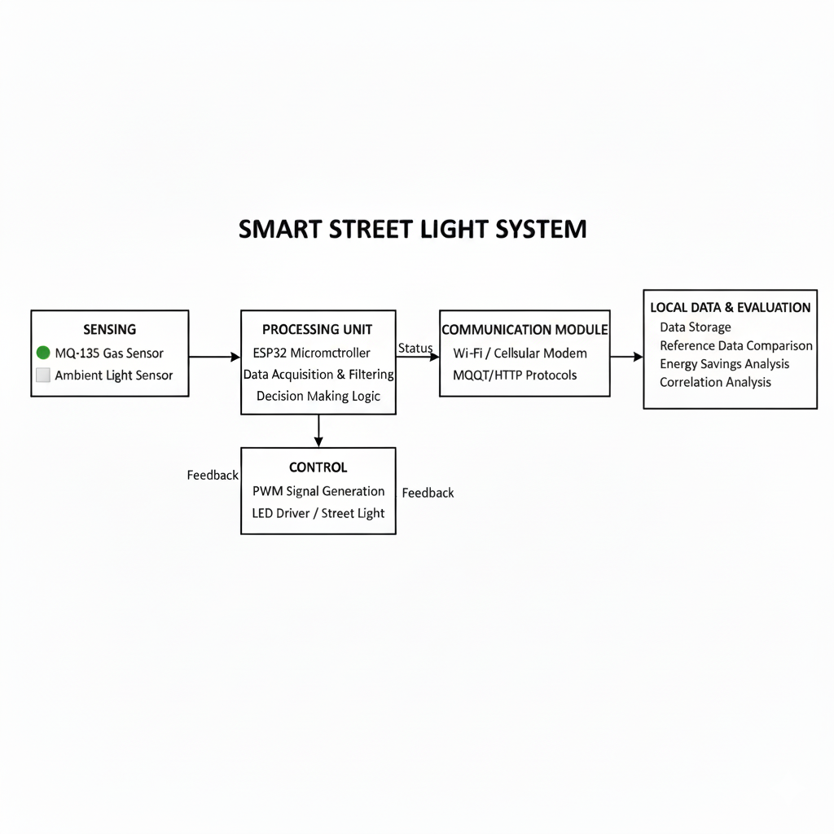
Block Diagram For Methodology

Slide 19
Result
The proposed air-pollution-controlled smart street lighting system was successfully implemented and tested in a controlled outdoor environment. The MQ-135 sensor was calibrated against publicly available air-quality index (AQI) data and showed a strong correlation (R² ≈ 0.82) with reference readings after applying linear regression and smoothing filters.
The system responded dynamically to variations in pollution levels. During periods classified as Good Air Quality, streetlight brightness was automatically dimmed to 40%, resulting in an average energy saving of 28–32% compared to constant full brightness operation. Under Moderate conditions, brightness was maintained at 70%, while Poor air quality triggered 100% brightness with a notification alert sent to the municipal dashboard.

Slide 20
Result
Sr. No | Timestamp | Air Quality (PPM) | Air Quality Status | Street Light Status | Street Light Status
1 | 2025-09-28 18:00 | 80 | GOOD | ON | 40%
2 | 2025-09-28 20:00 | 150 | MODERATE | ON | 60%
3 | 2025-09-28 22:00 | 250 | POOR | ON | 80%
4 | 2025-09-29 00:00 | 350 | UNHEALTY | ON | 100%
5 | 2025-09-29 03:00 | 90 | GOOD | OFF | 0%

Slide 21
Conclusion
This study demonstrated a novel approach to integrating air-quality monitoring with adaptive street lighting using an MQ-135 sensor and ESP32 microcontroller. The system offers a low-cost, scalable solution for municipalities to address the twin challenges of environmental pollution monitoring and energy management. By dynamically adjusting lighting based on pollution levels, the solution ensures safety and visibility while conserving energy during low-pollution periods
The proposed system highlights the potential of leveraging existing infrastructure for sustainable smart-city applications. Although the MQ-135 has inherent limitations, careful calibration and sensor fusion can enhance reliability. Future extensions with advanced sensors, machine-learning algorithms, and larger deployments will strengthen the applicability of this model. Ultimately, this research underscores how smart infrastructure can play a pivotal role in fostering cleaner, safer, and more energy-efficient cities.

Slide 22
Bibliography
[1] F. S. El-Faouri, M. Sharaiha, D. Bargouth and A. Faza, "A smart street lighting system using solar energy," 2016 IEEE PES. Available: A smart street lighting system using solar energy | IEEE Conference Publication | IEEE Xplore
[2] M. Dwiyaniti, A. B. Kusumaningtyas, S. Wardono, K. Sri Lestari and Tohazen, "A Real-time Performance Monitoring of IoT based on Integrated Smart Streetlight," 2022 6th International Conference on Electrical, Telecommunication and Computer Engineering (ELTICOM), Medan, Indonesia, 2022
[3]S. Bhisikar, P. Jagtap, S. Sonawane, H. Sawant and P. Pisal, "Enhanced Streetlight Management: Using IoT and ESP32 for Automated Fault Detection," 2024 IEEE 5th India Council International Subsections Conference (INDISCON), Chandigarh, India, 2024
[4] STREET LIGHT CONTROL AND AIR QUALITY MONITORING SYSTEM 1Udhaya M, 2Susmitha K, 3Padmavathi V 1Scholar 1Anna University 2021 IJCRT | Volume 9, Issue 5 May 2021 | ISSN: 2320-2882
[5] R. Majumdar, A. Srivastava, D. Tulsian and V. P. Mishra, "IOT based Street Light Controlling Mechanism,"2019 International Conference on Computational Intelligence and Knowledge Economy (ICCIKE), Dubai, United Arab Emirates, 2019
[6] K. Sneha, N. Jnana Phaneendra Sathiraju and K. Harish sai, "Master Street Light System Integrating Automation and Air Pollution Monitoring for Urban Sustainability," 2024 5th International Conference on Intelligent Communication Technologies and Virtual Mobile Networks (ICICV), Tirunelveli, India, 2024
[7] B. Goyal et al., "Orchestrating a Sustainable, Energy-Efficient LoRa-Connected Lighting System for Next-Generation Smart Cities," 2023 International Conference on Sustainable Emerging Innovations in Engineering and Technology (ICSEIET), Ghaziabad, India, 2023
[8] N. Gopinath, D. Ezhilarasi, S. Kiruthika and S. Hemavathi, "Self-Activating Street Lights Using Sensors and Arduino," 2021 4th International Conference on Computing and Communications Technologies (ICCCT), Chennai, India, 2021
[9] Agramelal, F.; Sadik, M.; Moubarak, Y.; Abouzahir, S. Smart Street Light Control: A Review on Methods, Innovations, and Extended Applications. Energies 2023, 16, 7415. https://doi.org/10.3390/en16217415

